Slide 1
Aspect Oriented Programming
Paul Stovell
www.paulstovell.com

Slide 2
Tonight
What is Aspect Oriented Programming?
Three .NET AOP tools:
PostSharp
Castle Windsor
Policy Injection Application Block
Debugging and Performance
Real-world uses of AOP

Slide 3
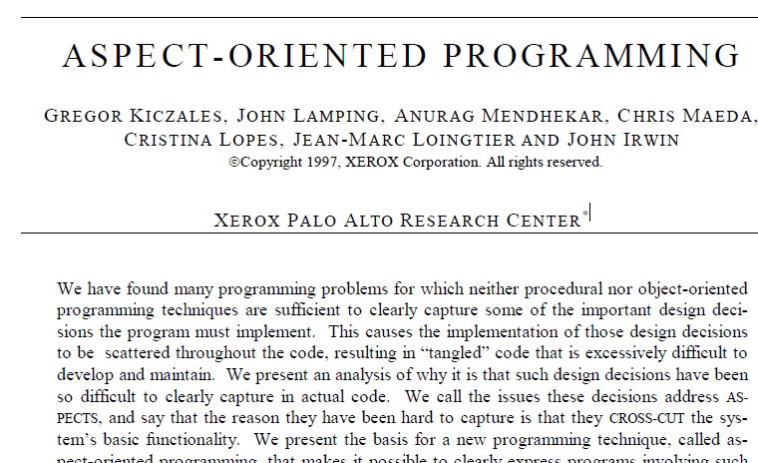
What is AOP?
Introduced in a 1997 paper by Xerox PARC.

Slide 4
What is AOP?
“Aspect-oriented programming (AOP) is a programming paradigm that increases modularity by allowing the separation of cross-cutting concerns, forming a basis for Aspect-oriented software development.”
Wikipedia

Slide 5
Examples
Logging/tracing
Validation
Change notification
Transaction/session management
Retry/timeout code
Threading
Authentication (Code Access Security)
...other code you wish to reuse

Slide 6
Demo: Logging the old way

Slide 7
Tool #1: PostSharp
www.postsharp.org
Dual licensed
LGPL/Free for use
Commercial license to extend (and for support)
Compile-time (IL Weaving)

Slide 8
Demo: Logging with PostSharp

Slide 9
Tool #2: Castle Windsor
www.castleproject.org
Open source
Runtime (Reflection.Emit)

Slide 10
Demo: Logging with Castle Windsor

Slide 11
Tool #3: EntLib Policy Injection
www.codeplex.com/entlib
MS-PL (Source available)
Runtime

Slide 12
Demo: Logging with Policy Injection

Slide 13
Pros/cons?
Discuss

Slide 14
Other Uses of AOP
PostSharp
Adding INotifyPropertyChanged
Validating Method Arguments
Windsor
Caching
Retry/circuit breaker
Policy Injection
Exception Handling
Authorization

Slide 15
Summary
www.paulstovell.com
www.github.com/paulstovell
paul@paulstovell.com
www.balsamiq.com
Questions/comments?

